Slide 1

Proposal Defense
Team
Abdullah Basit | 20I - 0623
Muhammad Abubakar Siddique | 20F - 0101
Areeba Rasheed | 19F - 0238
Supervisor
Supervisor | Mr. Usman Ghous

Slide 2
Team/Company Name:
Project Name/Title:
Team Alpha
Smart Surveillance System (SSS)

Slide 3

LOGO

Slide 4
Outline
Project Introduction
Problem Statement
Need for Project
High Level Features
Module Details
Dataset Details
Related Projects
Comparison with other projects
Tools and Technologies
High Level System Diagram
References

Slide 5

Project Introduction
SSS, a cutting-edge solution, designed to bridge surveillance gap prevalent in traditional CCTV systems within universities.
Advanced Technology Integration: Introduces the use of facial recognition, computer vision, machine learning, and behavior analysis to develop a comprehensive surveillance system.
Proactive Risk Management: Focuses on providing precise individual tracking and specific unwanted behavior detection (Smoking, Littering, Fighting) to ensure proactive responses.
Overcoming Human Limitations: Recognizes the inherent limitations of human monitoring, as people cannot effectively oversee multiple cameras all the time, leading to missed incidents. Our project aims to fill this gap by ensuring continuous monitoring.

Slide 6

Problem Statement
Traditional CCTV systems at universities lack real-time tracking and analysis of individual activities, creating a gap in technology that fails to address safety, security, and ethical considerations effectively.
Problem
This technological shortfall leads to an unsafe environment for individuals as it fails to uphold ethical standards by not detecting and managing incidents like smoking, fighting, and littering proactively.
Consequences
Our project proposes an integrated surveillance system employing facial recognition, behavior detection (smoking, fighting, littering), location tracking, and time analysis. Utilizing machine learning technology, our system will be designed to provide individual tracking and anomaly alerts, thereby enhancing the security infrastructure to address the ethical challenges in university environments.
Solution

Slide 7
Need for project
Enhanced Surveillance Solution
Refined Behavior Analysis (Smoking, Littering, Fighting)
Reliable Monitoring System with immediate alert mechanism
Safe Campus Environment

Slide 8





High Level Features
Dashboard Overview
Live Video Feeds
A centralized web based dashboard displaying real-time data, alerts, and system status, allowing for a quick overview of the entire surveillance operation.
Access to live camera feeds with the ability to switch views, zoom, and track individuals using displayed ID’s in real-time across different cameras for detailed monitoring.
Activity Logs and Analytics
Alerts and Notifications Panel
Visual representation of data analytics and activity logs, including graphs and charts for easy interpretation of occurrences of behaviors.
A dedicated tab on the web based application for notifications and real-time alerts that require immediate attention.
Search and Filter Operation
Comprehensive search capability allows data querying by roll number, violation type, location, or time, with robust sorting and filtering options.

Slide 9


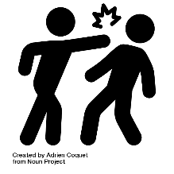




Modules
Facial Recognition Module
Smoking Behavior Detection Module
Identifies individuals in real-time for enhanced security and tracking.
Detect instances of smoking within the university to ensure the implementation of facility policies and health regulations
Fighting Behavior Detection Module
Littering Behavior Detection Module
Identify physical fights to maintain safety, and security with in facility.
Detect littering within the facility by detecting the dumping action to ensure a hygienic environment
Time and Location Logging Module
Data, Reporting, and Alert System
Real-time individual tracking through live camera feeds, recording location by camera name and timestamp for easy retrieval upon alerts.
Database records individual’s location and timestamp on occurrence of incidents of smoking, fighting, and littering, triggering alerts in the web application.

Slide 10
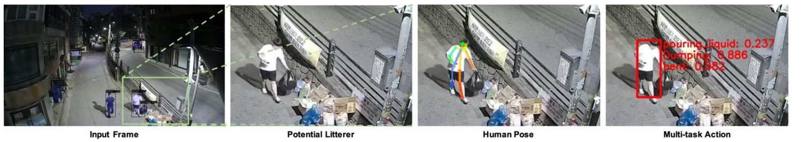
Dataset Details
Facial Recognition Module
Student RFID Dataset and CCTV recordings of our university have been requested from campus administration.
Smoking Behavior Detection Module
Utilizes the HMDB: a large human motion database’s dataset on smoking [2].
Fighting Behavior Detection Module
The dataset consists of Vision-based Fight Detection from Surveillance Cameras that are uploaded on YouTube [5].
Littering Behavior Detection Module
Requested the authors of “Anti-Litter Surveillance based on Person Understanding via Multi-Task Learning” [6] for their self-created dumping action detection dataset.

Slide 11
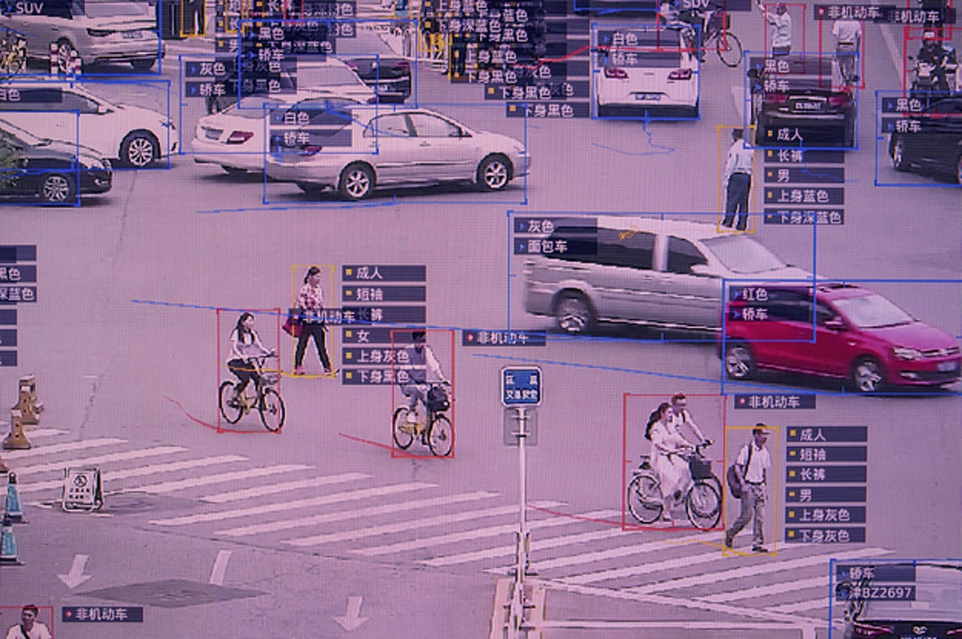
Related Projects
China Social Credit Surveillance System
It is a complex framework intended to assess and influence the behavior of individuals, companies, and organizations by aggregating data from financial, legal, and social interactions to enforce compliance and promote trustworthiness within society.
Punjab Safe City Project
The project involves using AI in traffic cameras specifically to monitor compliance with traffic laws, such as helmet use by motorcyclists, to enhance road safety. This initiative is aimed at improving traffic management using technology.

Slide 12
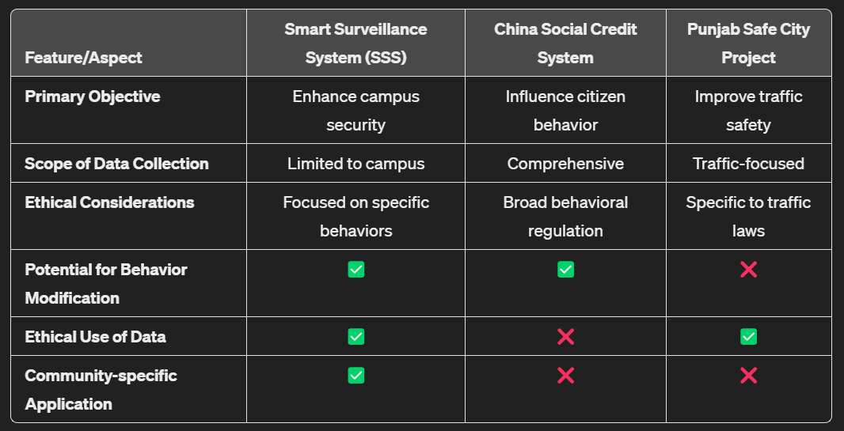
Comparison

Slide 13









Tools/Technologies/Environment

Slide 14
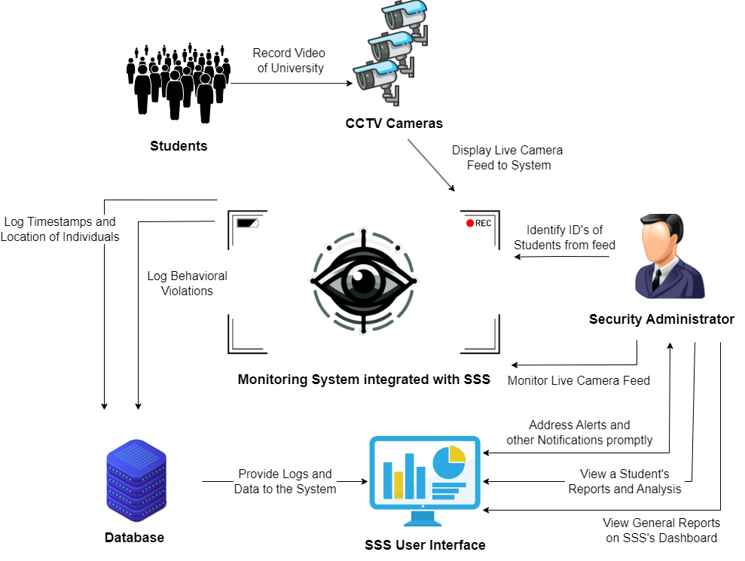
High Level System Diagram

Slide 15
References
https://www.scmp.com/economy/china-economy/article/3096090/what-chinas-social-credit-system-and-why-it-controversial
https://tribune.com.pk/story/2454420/bikers-sans-helmet-to-receive-e-challan
https://www.analyticsvidhya.com/blog/2022/06/yolo-algorithm-for-custom-object-detection
https://serre-lab.clps.brown.edu/resource/hmdb-a-large-human-motion-database/
https://github.com/seymanurakti/fight-detection-surv-dataset
https://www.bmvc2020-conference.com/assets/papers/0279.pdf

